Slide 1
Predicting Footballers Market Values
Using 2008 - 2017 data from transfermarkt.co.uk
Christopher Williams
Capstone
GA DSI
Austin
Feb 2019

Slide 2
Contents
The Data Science Problem
The Data
Getting it
Data Challenges
Seeing it
Data Assumptions
Facts
Modeling
Regression
Classification
Model Results
Conclusions

Slide 3
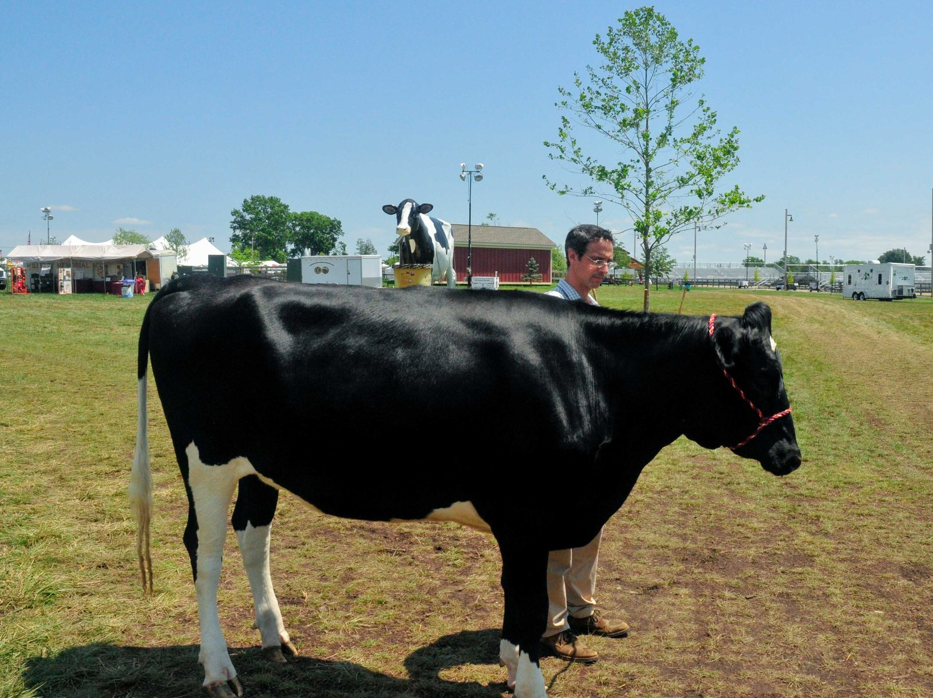
Data Science Problem
In this project the problem I'm seeking to understand is how well annual statistics predict the estimated market values of professional footballers in the top 5 European leagues.
Using players annual data to see how applicable machine learning prediction models are on market values.
Data: comes from transfermarket.co.uk which has crowd sourced market values for players in the top flight of European football over the last 10 years. Think Penelope and wisdom of the crowds!

Slide 4
The Data
Getting it

Slide 5
Data Challenges
Most sites focus on the just high level stats like: shots, goals, assists, cards, minutes-played, and games played.
Lack of one site with all the stats desired for true merits of each different position.
Complex Process to unify all the stats needed to build a truly complete dataset at scale that could be used to predict market values of players in defensive positions along with forwards & midfielders.

Slide 6
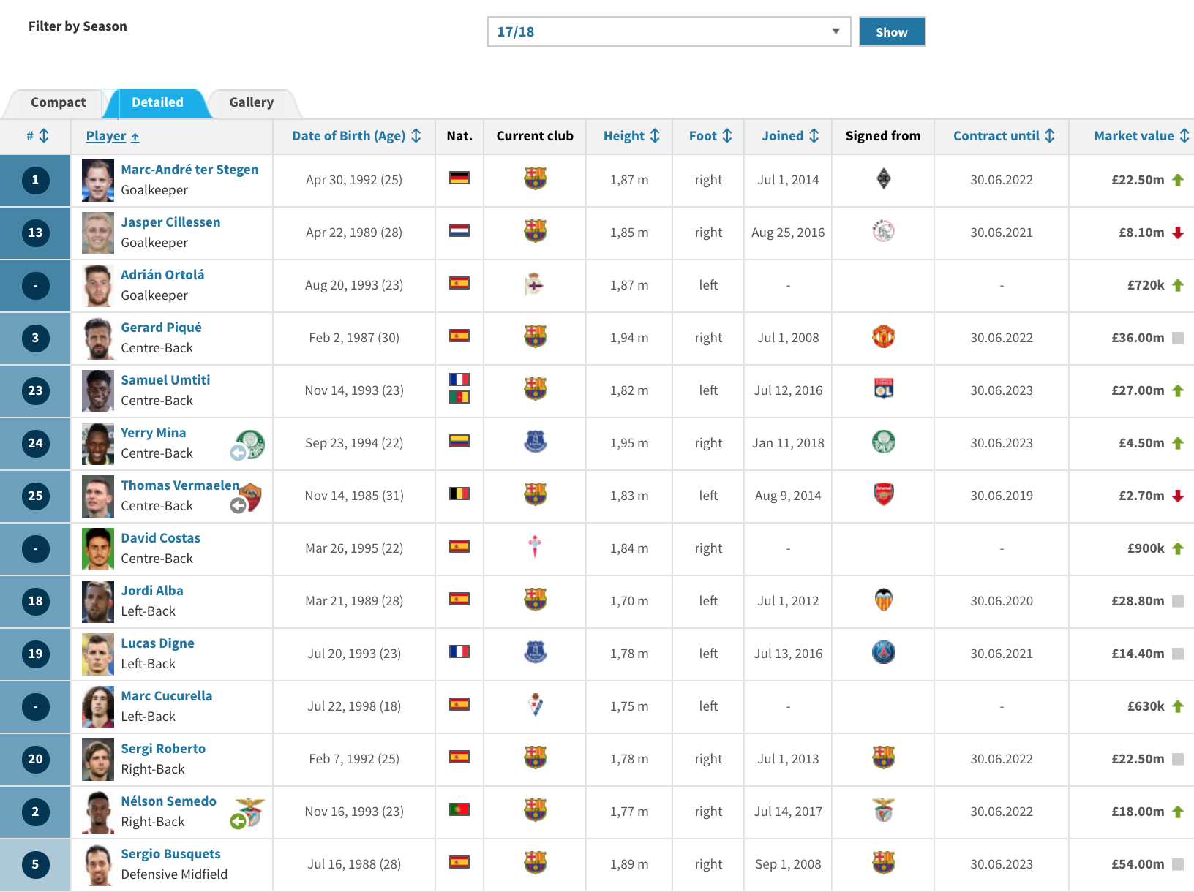
Data Collection
Market Values
2008 - 2017
DOB
Nationality
Height
Foot
Joined
Signed From
Transfer Fee
Contract Until
Market Value
Source: transfermarkt.co.uk

Slide 7
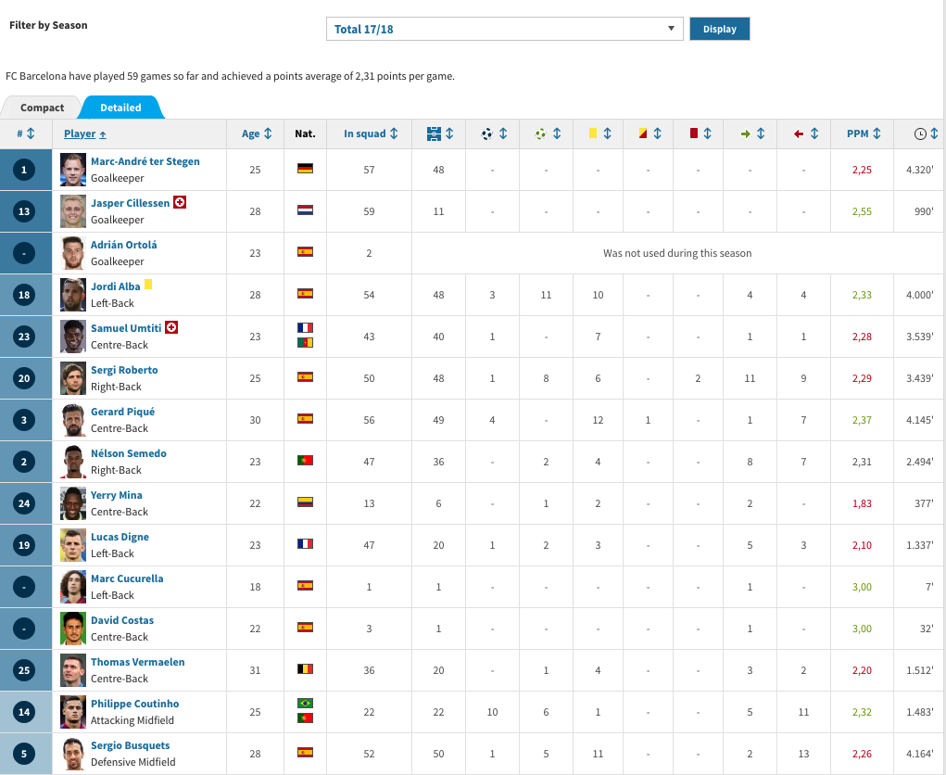
Data Collection
Player’s Yearly Stats
2008 - 2017
In-squad
Appearances
Goals
Assists
Yellow Cards
Second Yellows
Red Cards
Substituted On
Substituted Off
PPM
Time Played

Slide 8
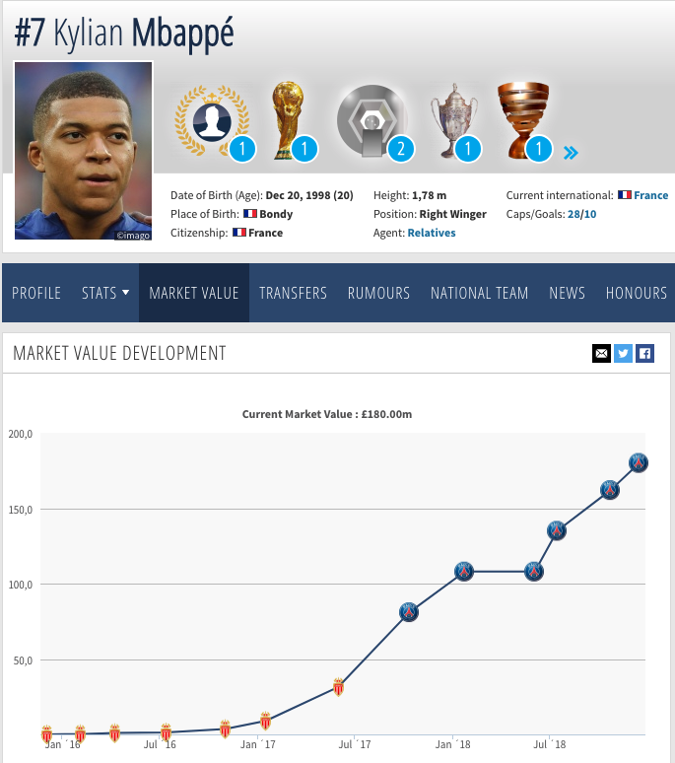
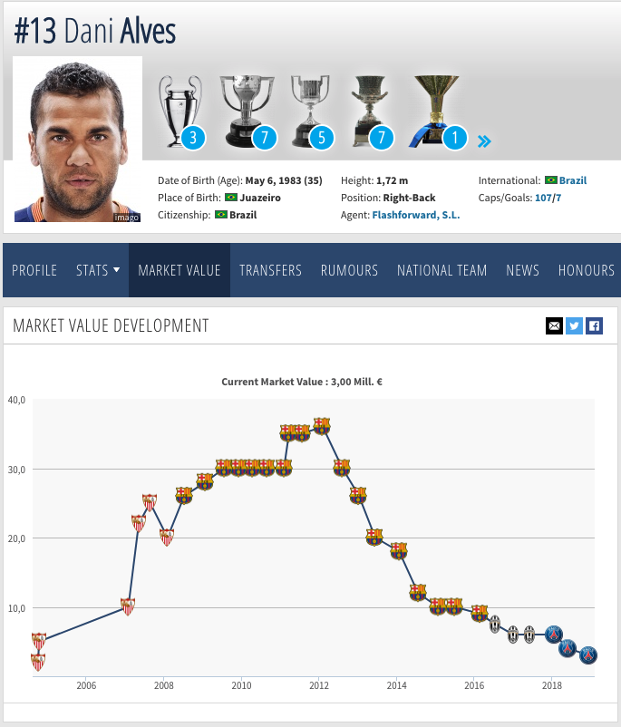
Kylian Mbappé vs Dani Alves

Slide 9
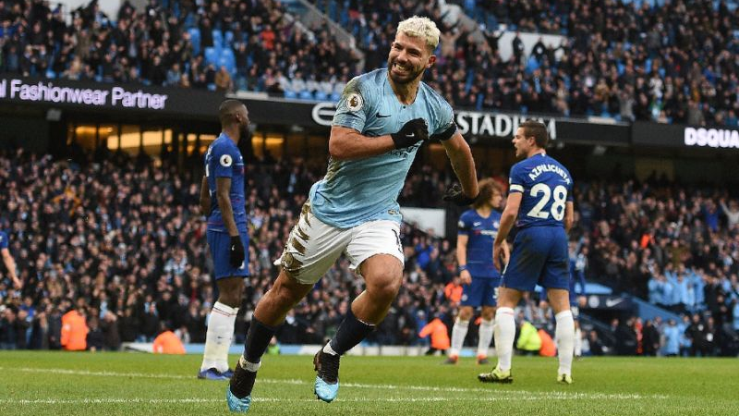
Sergio Aguero, hat trick
Man City 6, Chelsea 0. Feb 10
￡67.5m market value 2018

Slide 10
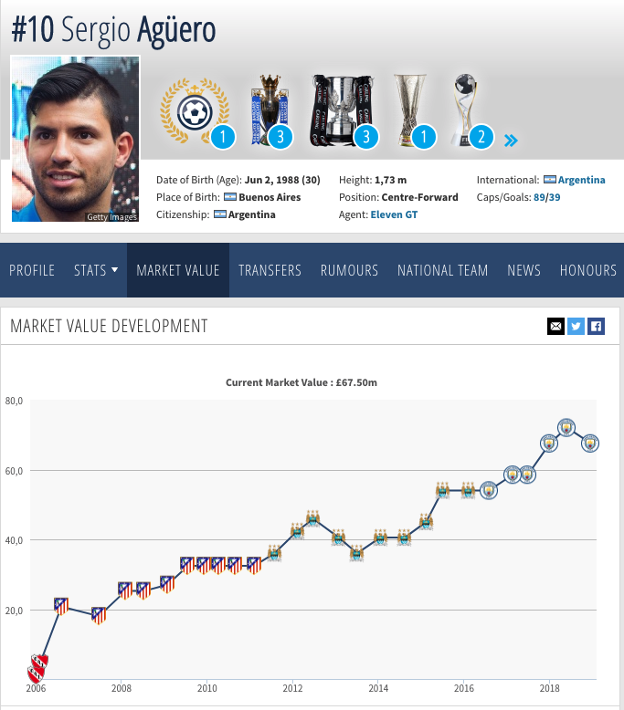
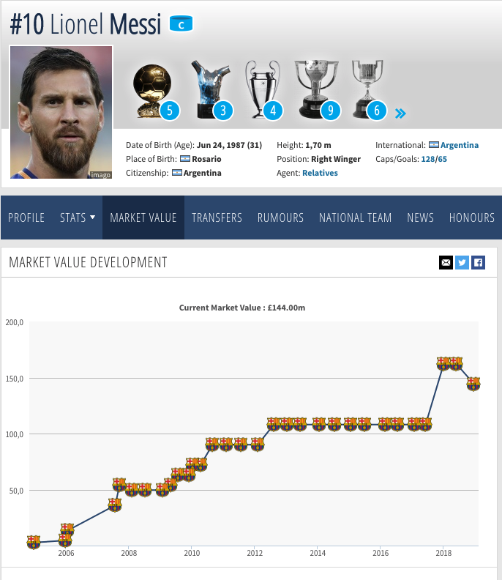
Sergio Agüero vs Lionel Messi

Slide 11
The Data
Seeing it

Slide 12
Data Assumptions. How to deal with it.
How to deal with defenders & goalies compared to midfielders & forwards who score more goals, have more assist?
Min number of appearances?
Min number of time played?

Slide 13
Facts about the data
Top 5 European Leagues
Spanish La Liga
French Ligue 1
English Premier League
Italian Serie A
German Bundesliga (only 18 teams)
30504 observations over 2008-2017
Dropped to 24,632
Average Market Value of 3,257,152
Median Market Value of 900,000
10584 unique players
1.85 average goals per season per player
17.3 average appearances
24 years old on average

Slide 14
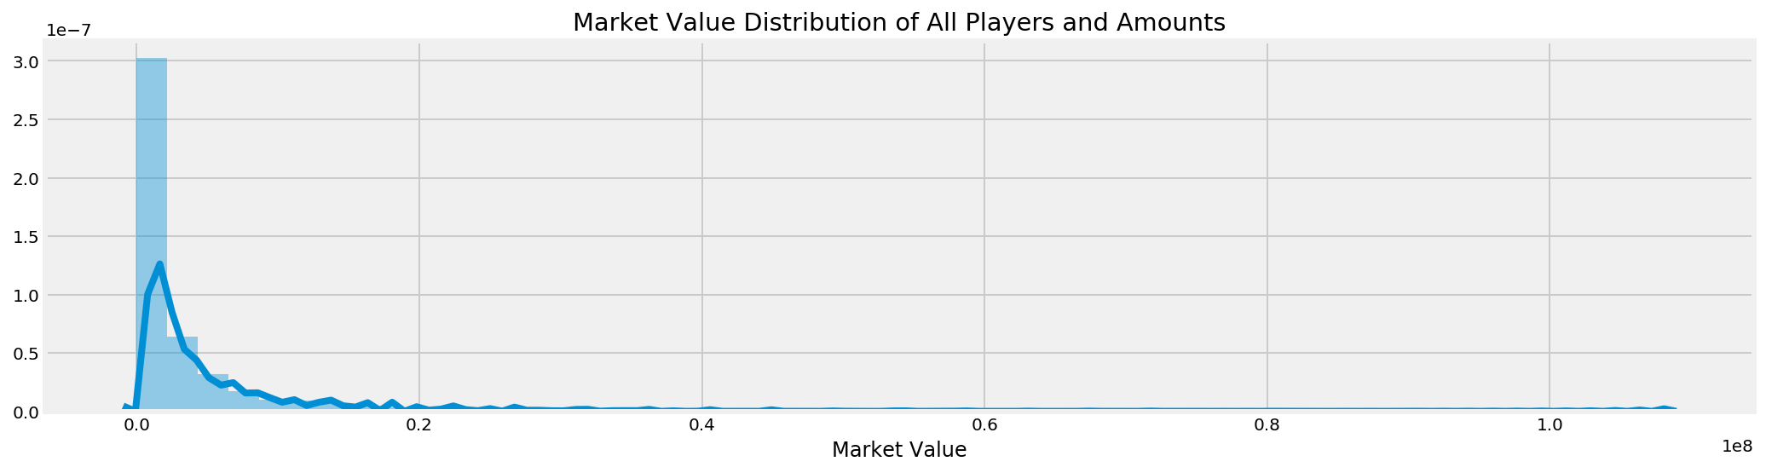
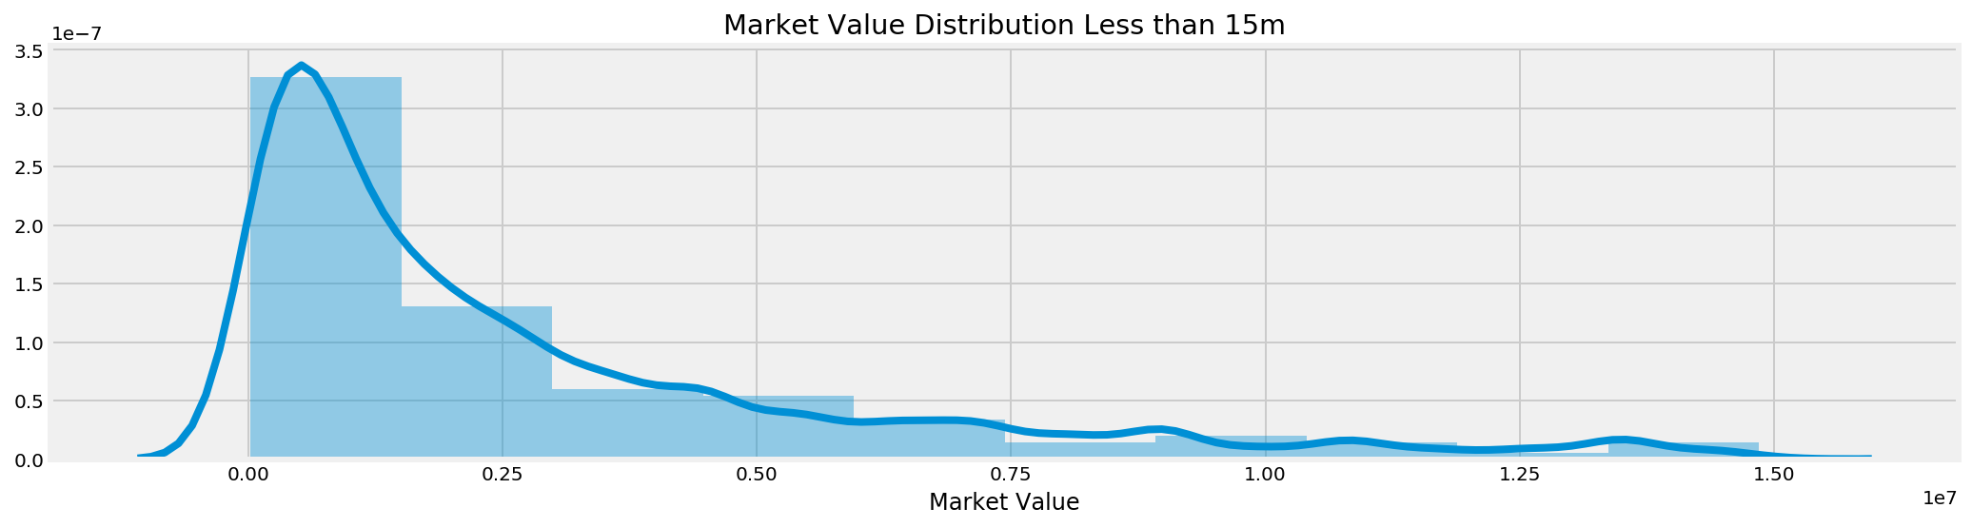

Slide 15
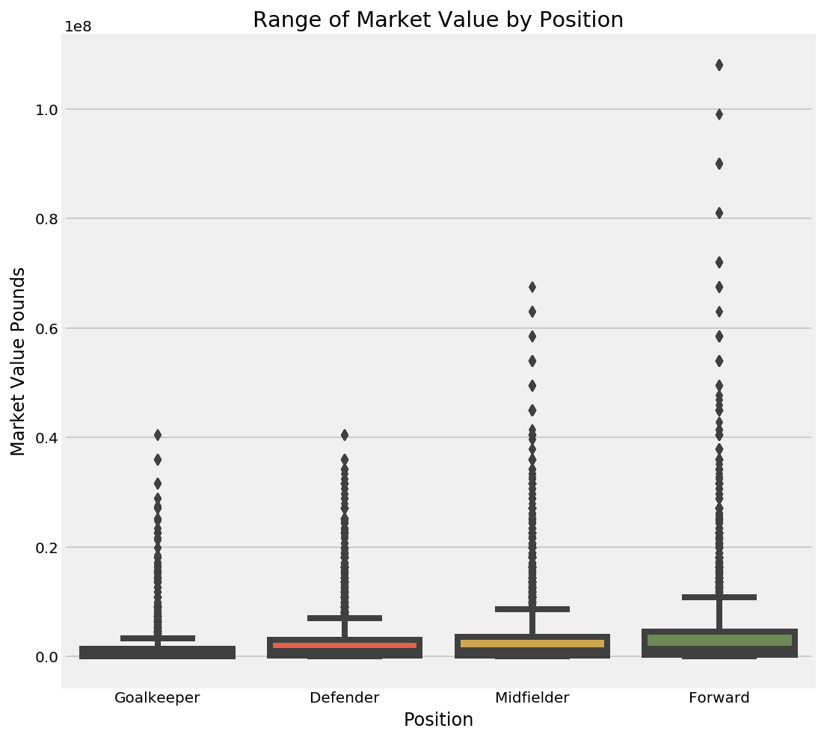
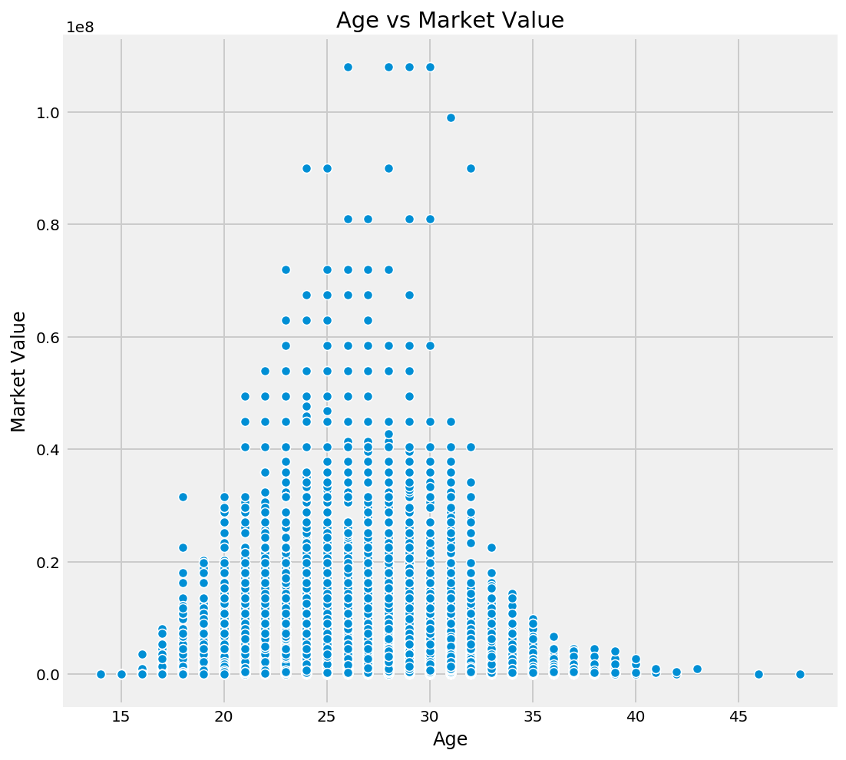
Position and Age vs Market Value

Slide 16
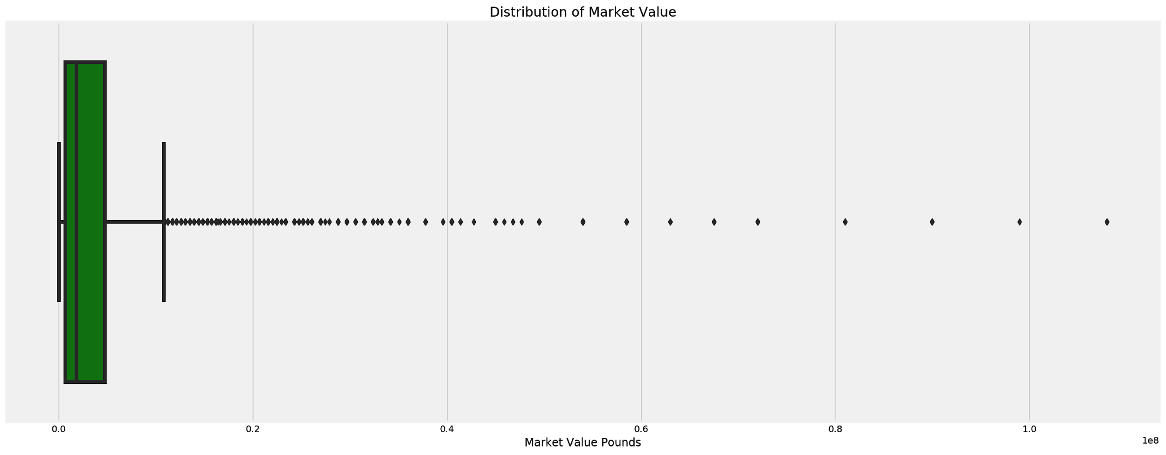
Distribution of Market Values

Slide 17

Distribution of Market Values

Slide 18
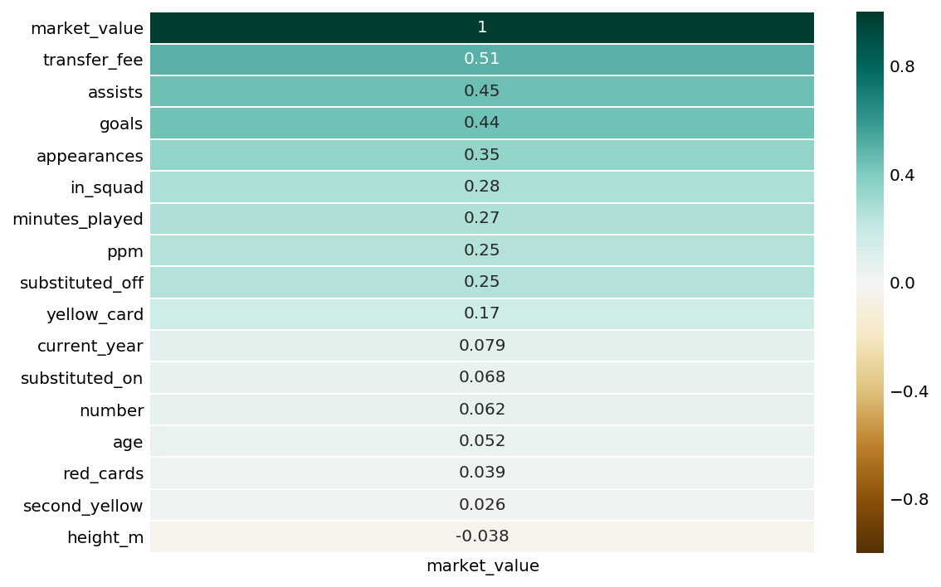
Correlation with market value

Slide 19
Modeling
Doing it

Slide 20

Dani Alves
Paris Saint-Germain
￡6m market value 2018
￡9m market value 2016
￡20m market value 2009

Slide 21
Regression Models
LinearRegression
Ridge
RidgeCV
Lasso
LassoCV
ElasticNet
ElasticNetCV
DecisionTreeRegressor
BaggingRegressor
KNeighborsRegressor
RandomForestRegressor
AdaBoostRegressor
SVR

Slide 22
Targets
Main Target is Market Value
Primary objective for this project
21,859 observations
Transfer Fee
Not primary objective for this project
Limited Observations 4030
Classification of players by general position
Forward
Midfielder
Defender
Goalkeeper

Slide 23
Features
Hard Features:
Age
Market -Value (not included when target)
Transfer-Fee (not included when target)
In-Squad (included on bench)
Appearances (games played)
Goals
Assists
Yellow Cards
Second Yellow Cards
Red Cards
Substituted On
Substituted Off
PPM
Minutes Played
Categorical Features
98 clubs
Position
Foot
Right
Left
Both

Slide 24
Regression Models
Can we use the stats to predict the market value of a player?
Let’s do it with just the raw numerical stats and then the dummied categorical ones.
How do we slice the data?
What happens when we feed it to the machine?

Slide 25
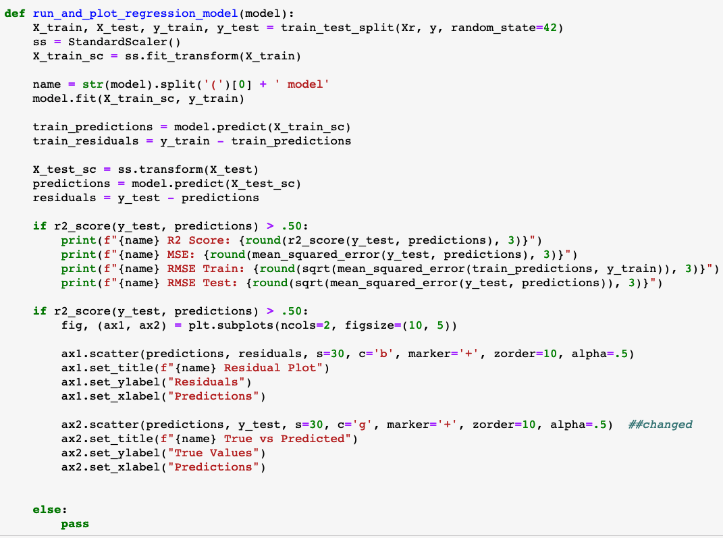
Regression Model Function

Slide 26
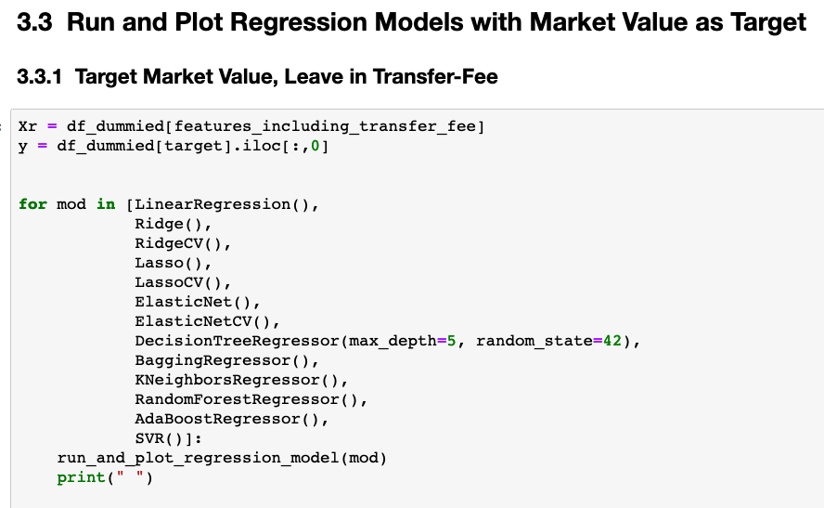
Regression Model For Loop example

Slide 27
Classification Models
Can we use the stats to determine which position a player is?
Use all numerical stats and include market value and transfer value.

Slide 28
Model Results

Slide 29

Cristiano Ronaldo
Market value 100m

Slide 30
Purely Statistics
Without dummying data - taking into account solely the 14 numerical annual statistics:
Transfer Fee - Included and not in some various as correlation was high at 51%
Age
Height - meters
In-Squad
Appearances
Goals
Assists
Yellow Cards, Second Yellows and Red Cards
Substituted On & Off
PPM
Minutes Played

Slide 31
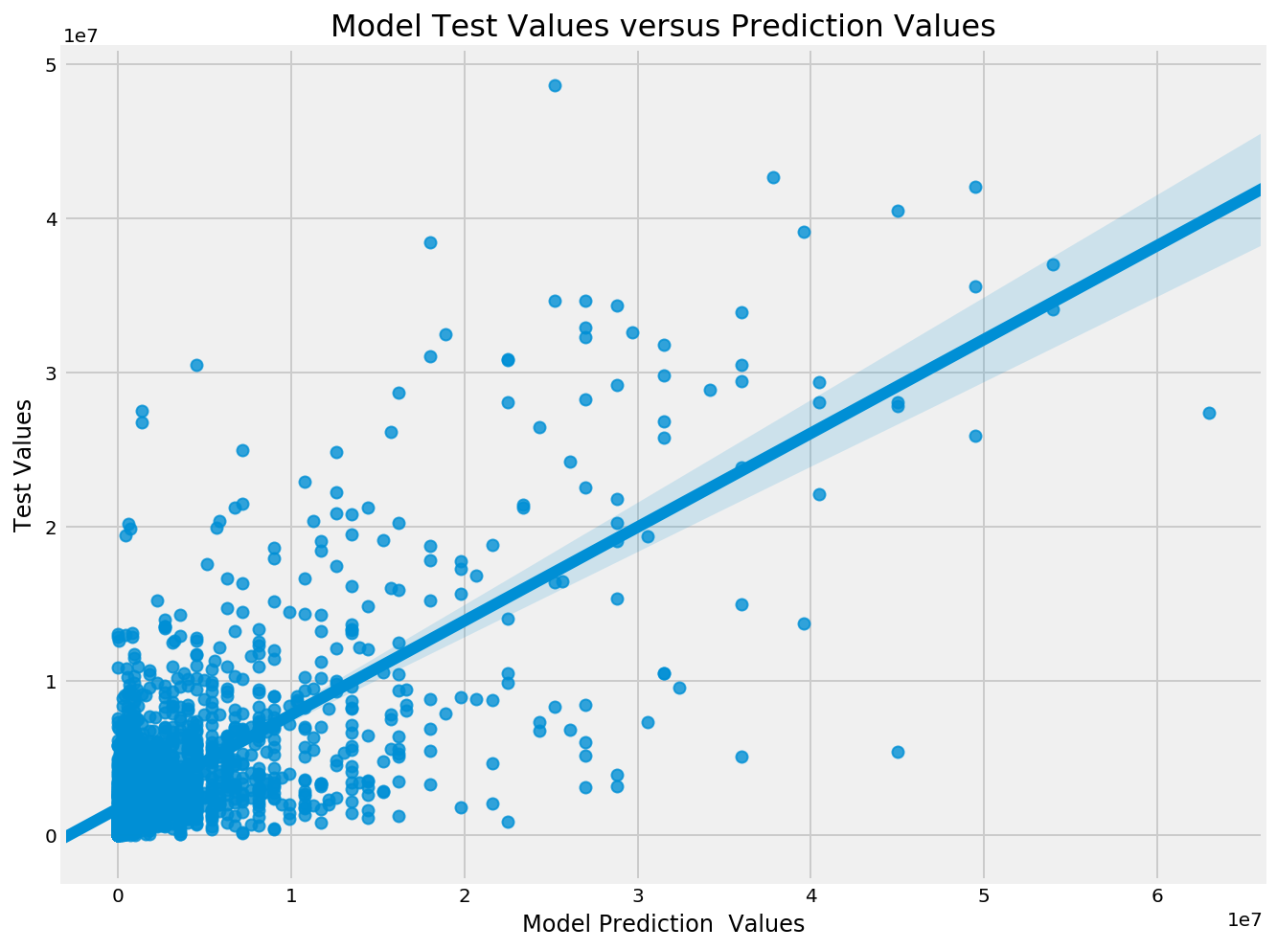
Regression Model Performance
No Categorical
Without dummying data
Only numerical statistics, no categorical data.
Model for forwards (including transfer fee) :
LinearRegression model R2 Score: 0.585 LinearRegression model MSE: 42,765,455,460,624 LinearRegression model RMSE Train: 6,819,546 LinearRegression model RMSE Test: 6,539,530

Slide 32
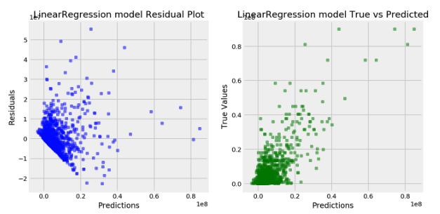
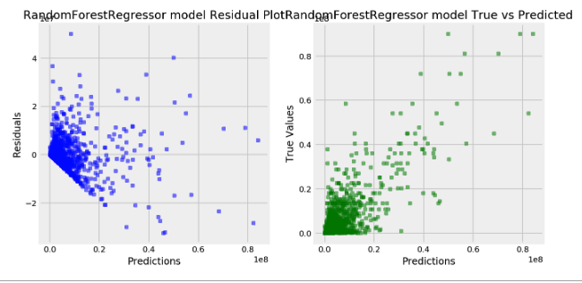
Regression Model Performance
No Categorical
Performance of players with more than 540 minutes
played ~ 6 games.
16183 observations with 28 features - no dummies
LinearRegression model R2 Score: 0.585 LinearRegression model MSE: 42765455460624.98 LinearRegression model RMSE Train: 6819546.765 LinearRegression model RMSE Test: 6539530.217
RandomForestRegressor model R2 Score: 0.607 RandomForestRegressor model MSE: 40548077649726.484 RandomForestRegressor model RMSE Train: 2792440.133 RandomForestRegressor model RMSE Test: 6367737.247

Slide 33
Dummying Features
With dummying data - taking into account categorical data:
Foot
right, left, both
Team
98 different ones
Position
4 major
Total Features - 120

Slide 34
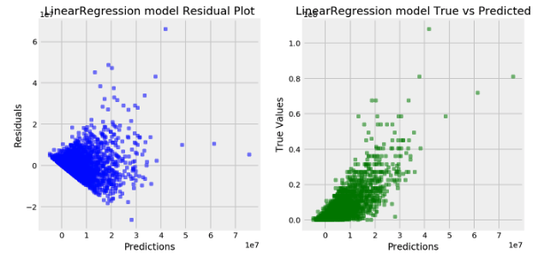
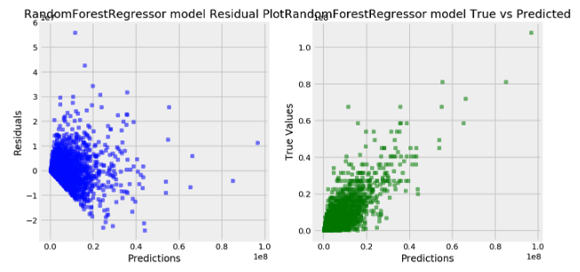
Model Performance with Categorical
Best Performance was on players with more than 540 minutes
played ~ 6 games.
16183 observations with 130 features - dummied included
LinearRegression model R2 Score: 0.621 LinearRegression model MSE: 23950821762912.28 LinearRegression model RMSE Train: 4860018.106 LinearRegression model RMSE Test: 4893957.679
RandomForestRegressor model R2 Score: 0.675 RandomForestRegressor model MSE: 20523282524001.484 RandomForestRegressor model RMSE Train: 2036772.958 RandomForestRegressor model RMSE Test: 4530262.964

Slide 35
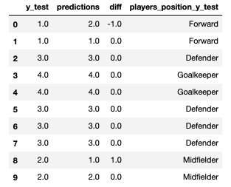
Classification Model Performance
Support Vector Classification
SVC model Training Accuracy Score: 0.755 SVC model Testing Accuracy Score: 0.74
DecisionTreeClassifier model Training Accuracy Score: 1.0 DecisionTreeClassifier model Testing Accuracy Score: 0.628

Slide 36

Conclusions
Gather more stats
Get stats that demonstrate strengths of defenders, midfielders and goalkeepers
Dealing with Outliers
Leave them in if you have enough data that supports their value
Much of Futbol is Not Tracked
There is opportunity to find more golden players like Kylian Mbappé, can you use data to do it?

Slide 37


